Slide 1

Automatic Number-Plate Recognition (ANPR)
EN.525.746 Image Engineering, Summer 2021
Final Project Presentation
Hung Nguyen
Special thanks to Professor Tim Miller and everyone for a phenomenal summer.
Notes:
Hey everyone, this is Hung and I will be doing a presentation on the topic of Automatic Number-Plate Recognition System, or ANPR for short. Before diving in, I just want to give a shoutout to Professor Tim Miller and everyone for a phenomenal learning experience this summer.

Slide 2
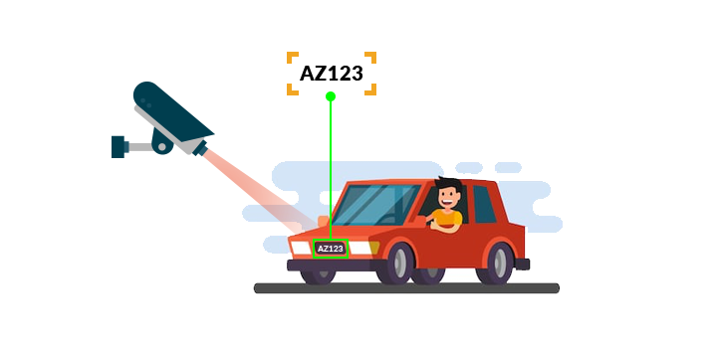
Introduction
Automatic Number-Plate Recognition (ANPR) system is a system that capture, detect and uses Optical Character Recognition (OCR) algorithms to read vehicle number plates without human intervention.
Applications:
Law enforcement
Border control
Fast food drive-through
Also known as:
Automatic license-plate recognition (ALPR)
Automatic vehicle identification (AVI)
Vehicle license-plate recognition (VLPR)
Image Source: https://www.theproche.com/2020/08/19/what-is-anpr/
Notes:
So as a quick introduction.
Automatic Number-Plate Recognition system is a system that capture, detect and uses Optical Caracter Recognition algorithms (OCR) to read vehicle number plates without human intervention, hence, the term automatic in its name.
Some very common applications of this technology include law enforcement, border control and somewhat of a more relatable application, fast-food drive through.
The ANPR system also goes by many other names and some might call it Automatic license-plate recognition (ALPR), automatic vehicle identification (AVI) and vehicle license-plate recognition (VLPR). So if you see these terms around, they pretty much refer to the same system that I will be diving into for this presentation.

Slide 3
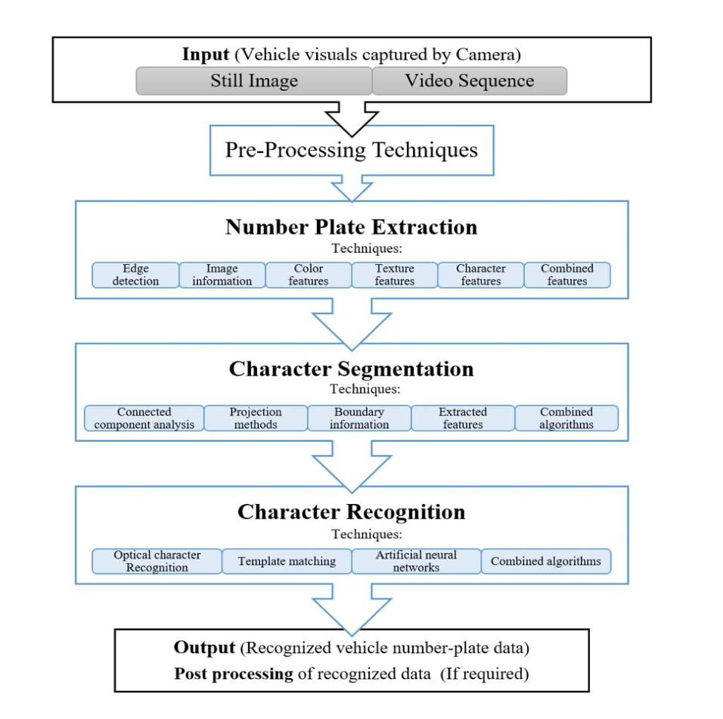
General Procedure of ANPR System
Notes:
Here is a general procedure of ANPR system, or in other words, a broad overview of the steps the system has to go through… basically from the first frame when the image of the car is taken to when the system is able to return readable characters of the license plate.
The first step is obviously the process of capturing a picture of the car with the license plate and use that as an input for the system.
Next, it will involve some basic pre-processing techniques, and these could be anything basic such as increasing the contrast or lowering the brightness, or it could be a little more advance such as turning the picture into grayscale or binary. I personally believe this step, along with the input, are the two most important step in the system, and you will see what I mean in a bit, as well as the concept of ‘frontloading’.
Next up, we will perform the extraction of the number plate from the front of the car. Some common techniques include edge detection and image information. My personal favorite and one that I used in the demo is edge detection.
Character segmentation is when you split up the plate into individual characters, and MATLAB is actually a very powerful tool that make this step very easy.
Lastly, we have character recognition. Now there are many different techniques for OCR and some even involve deep learning, but due to the time constraint, I have decided to settle with template matching for my demo.
Do keep this procedure in mind as we go through each of these steps. So first, image input into the ANPR system.

Slide 4
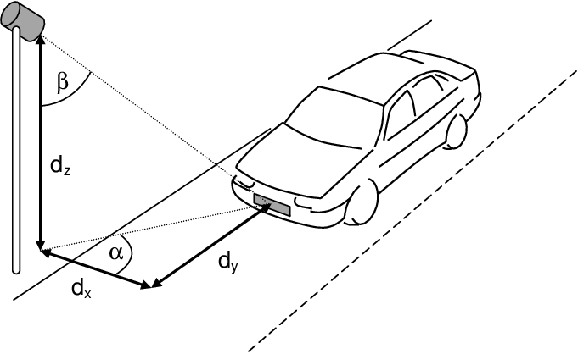
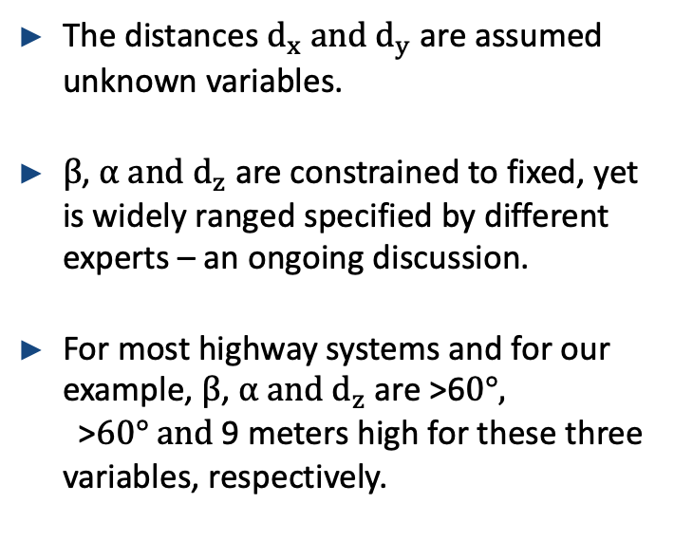
Input
The distances $d_{x} and d_{y}$ are assumed unknown variables.
$β$, $α and d_{z}$ are constrained to fixed, yet is widely ranged specified by different experts – an ongoing discussion.
For most highway systems and for our example, $β$, $α and d_{z}$ are >6$0°,$>$60° and$9 meters high for these three variables, respectively.
Notes:
On the right side we have a 2D visualization of what it would look like when a car is coming down the road and the ANPR camera is set up right off the road. The distances dx and dy are unknown and it is usually what one need to solve for depends on what is given for the other values. The angles Beta, Alpha and dz are contrained to fixed, yet is widely ranged specified by different experts depending on the application. For example, most systems has the angles Beta, alpha to be both at least 60 degrees and the height dz to be between 5-9 meters. A highway system would want a recommended dz of 9 meters, while for a fast-food drive through, it might not be necessary to have a camera that high. For calculation purposes, I will be using 60 degrees, 60 degrees and 9 meters for Beta, alpha and dz, respectively.

Slide 5
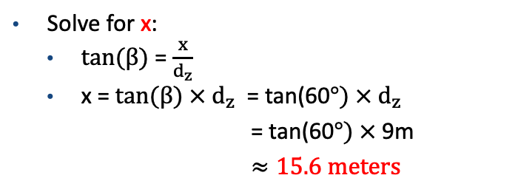

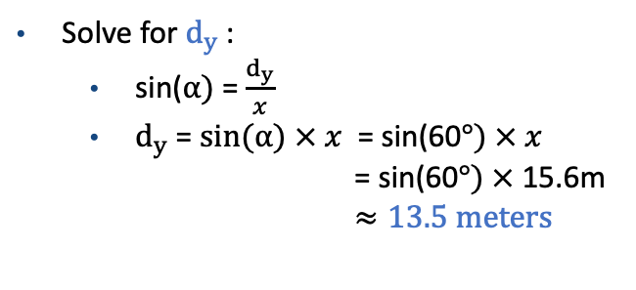
What is $d_{y} −the distance of the first frame?$
Solve for x:
$\tan{(β)}$ = $\frac{x}{d_{z}}$
x = $\tan{(β)}$ $× d_{z}$ = tan(60$°) × d_{z}$
= tan(60$°) ×$ 9m
$≈15.6 meters$
Solve for $d_{y}$:
sin($α)$ = $\frac{d_{y}}{x}$
$d_{y}$ = $\sin{(α)}$ $× x$ = sin(60$°) × x$
= sin(60$°) ×$ 15.6m
$≈13.5 meters$
x
Notes:
So again, the goal here to determine the distance dy, which is highlighted in blue. dy is the distance in which the first image of the car will be capture. Using what we learned in the geometric optics module, solving for dy is rather straightforward.
First we will need to solve for x that is highlighted in red of the figure to the right, and this can easily be done given that Beta is 60 degrees and dz is 9 meters, and x turns out to be approximately 15.6 meters. With x, we can then solve for dy, that turn out to be approximately 13.5 meters. This means that under this ANPR set up, we will be able to capture the first frame of the car at approximately 13.5 meters away.

Slide 6
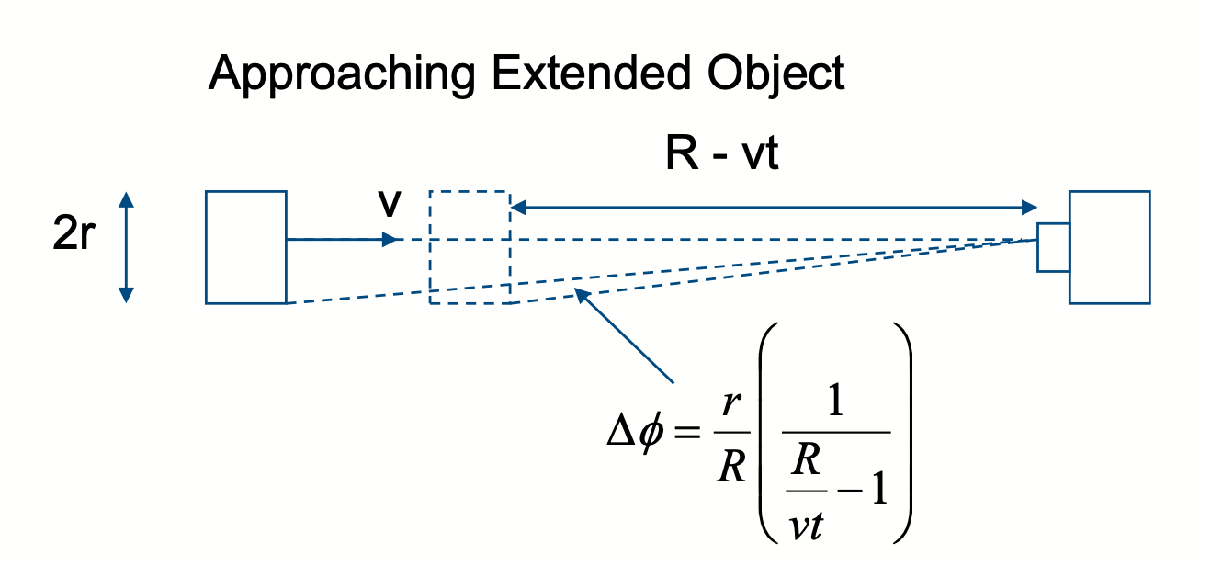
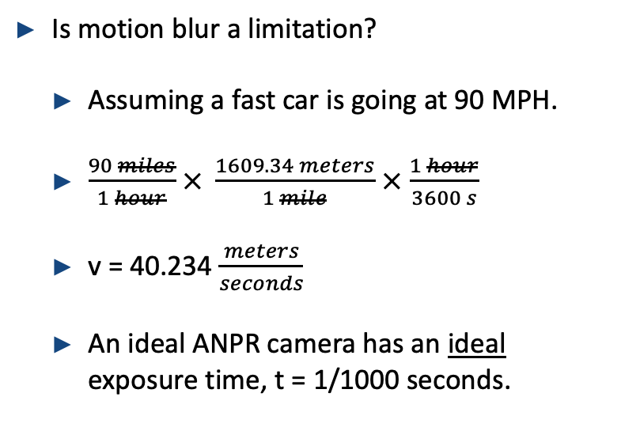
Motion Blur
Is motion blur a limitation?
Assuming a fast car is going at 90 MPH.
$\frac{90 miles}{1 hour}$ $× \frac{1609.34 meters}{1 mile}$ $×$ $\frac{1 hour}{3600 s}$
v = 40.234 $\frac{meters}{seconds}$
An ideal ANPR camera has an ideal exposure time, t = 1/1000 seconds.
Notes:
There are a few limitations that we do need to take into consideration, and the first one is motion blur. Motion blur is especially important in ANPR system because if the input is blurred, it is almost impossible for the rest of the system to make up for a bad input. So now we have to answer the question, with the current set up, is motion blur a limitation?
So to answer that question I have prepared a quick scenario. Assuming a fast car is going at 90 MPH, or 40.234 meters/seconds for calculation purposes, and assume that an ideal ANPR camera has an exposure time of t = 1/1000 seconds. Would motion blur be an issue in this case? Before I move on, I also want to emphasize the word ideal, and that is because a shutter speed of 1/1000 seconds is rather impressive for a camera.

Slide 7

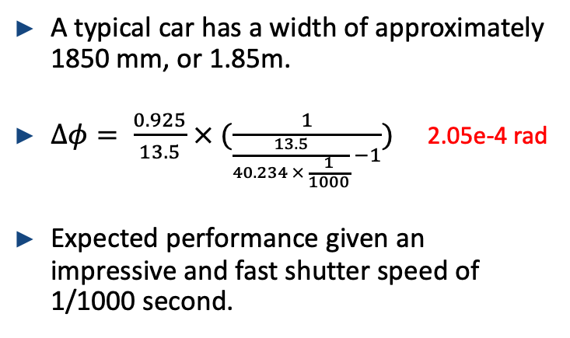
Motion Blur (continue)
A typical car has a width of approximately 1850 mm, or 1.85m.
$∆φ= \frac{0.925}{13.5}$ $× (\frac{1}{\frac{13.5}{40.234 × \frac{1}{1000}} −1})$ 2.05e-4 rad
Expected performance given an impressive and fast shutter speed of 1/1000 second.
$$≈$$
Notes:
Using the equation given in class to calculate the delta phi, or the change in angle, for an approaching extended object, I was able to conclude that the change in delta when a car is going at 90 MPH is 2.05x10^4rad, which is way less than 1 degree. This performance is actually expected given an impressive and fast shutter speed of 1/1000 seconds. So to answer the intial question whether motion blur would be a problem, the answer is no it should not be given the appropriate shutter speed settings. Most ANPR camera should have the appropriate shutter speed depending on its application.

Slide 8
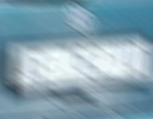
Motion Blur Summary
Velocity (MPH) | Sufficient shutter speed (s)
5 | 1/250
40 | 1/500
120 | 1/1000
Different applications have different requirement when it comes to determining the shutter speed for the camera
E.g. highway vs. fast food drive-through
Notes:
As a summary on motion blur, different applications have different requirement when it comes to determining the shutter speed for the camera. As noted in the table on the left. A shutter speed of 1/250 seconds should be sufficient for a car that is moving at 5 MPH, which is appropriate for lets say a fast food drive-through. However, for highway traffic it is recommend that we increase the shutter speed of the camera to avoid motion blur.

Slide 9
General Procedure of ANPR System
Notes:
As mentioned, we are now onto the actual processing portion of the ANPR system, which rely heavily on the software side as opposed to the hardware setup that we have just gone over.

Slide 10
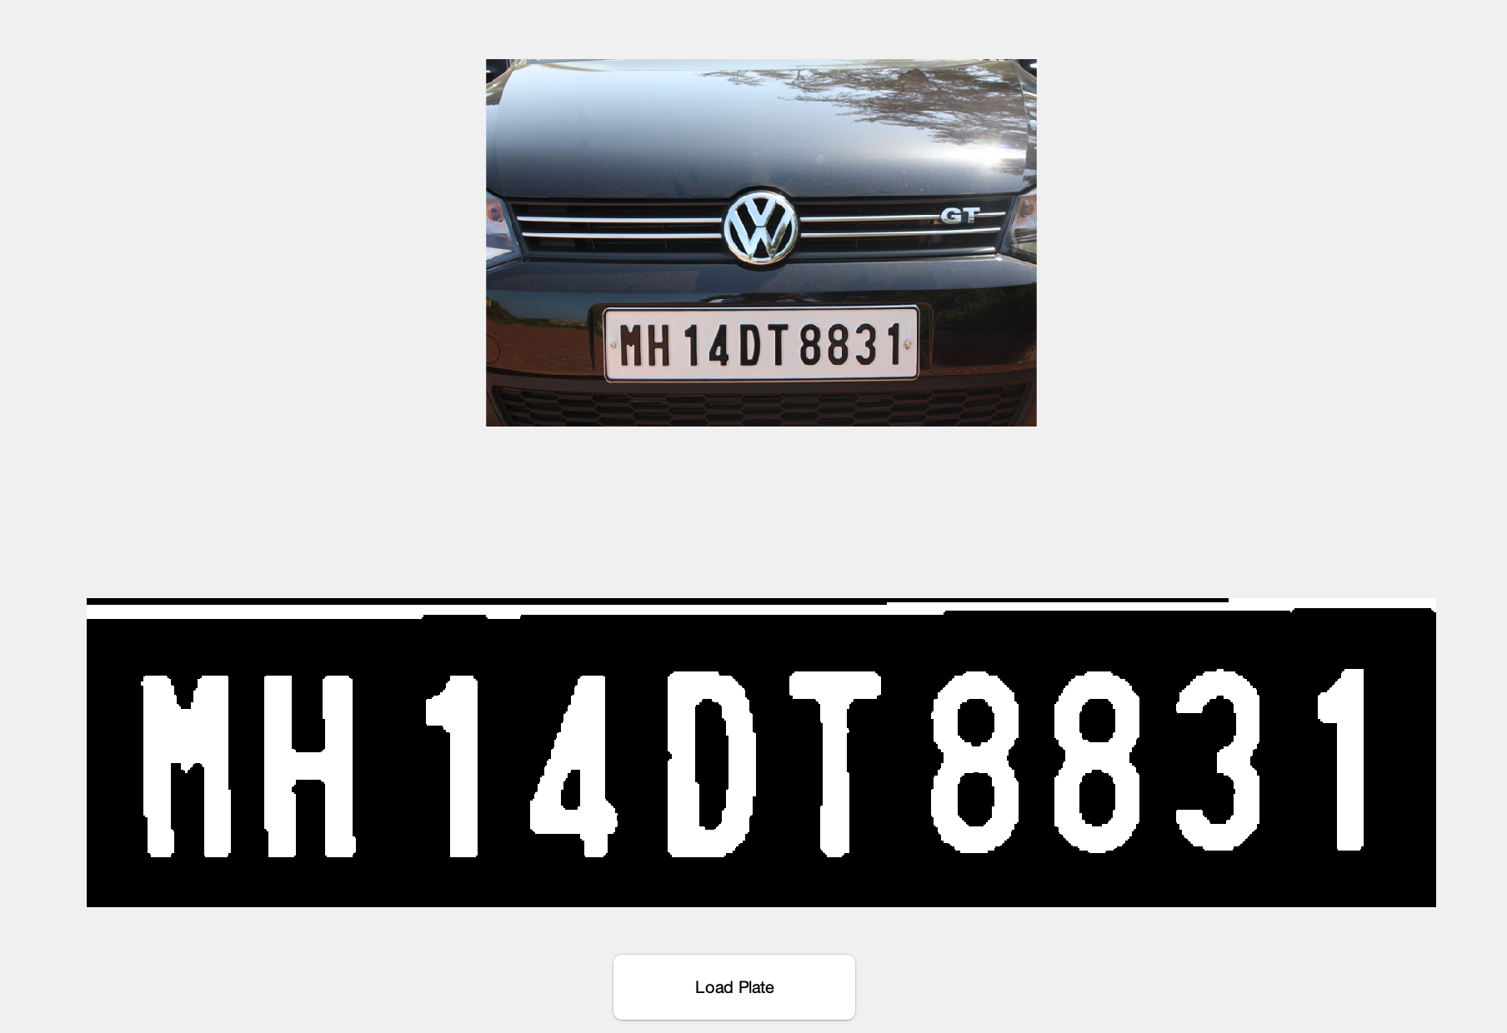
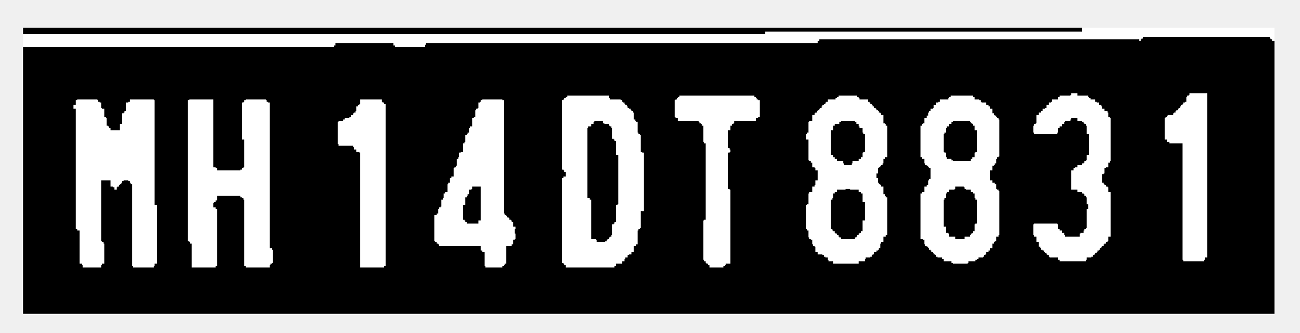
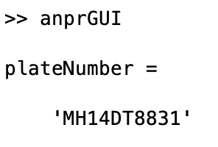
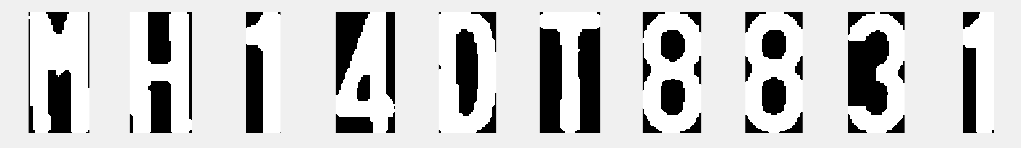
Processing Procedure – anprGUI.m
Detect and localize a license plate in an input image/frame.
Extract the features/characters from the license plate.
Apply OCR algorithms to recognize the characters.
Step #1
Step #2
Step #3
Notes:
For this presentation I have created a Graphical User Interface for the MATLAB demo that I’ll be showing at the end. The function to run it is called anprGUI.m and so I will be referring to this GUI a lot in the upcoming few slides.
For this slide, I have just simply broken down the three main steps that I have mentioned before. Step #1 is to detect and localize a license plate in an input image/frame. For demo purposes, I will be assuming that preprocessing techniques are already applied to these license plates, and they should be in good shape to go through the implemented system.

Slide 11

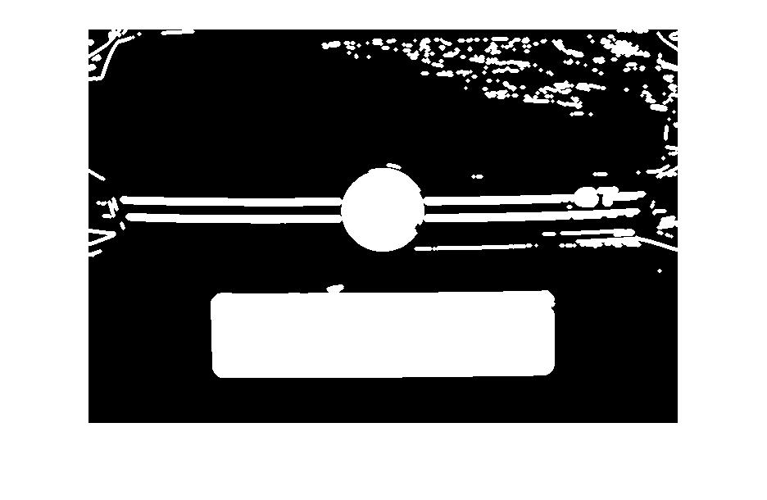
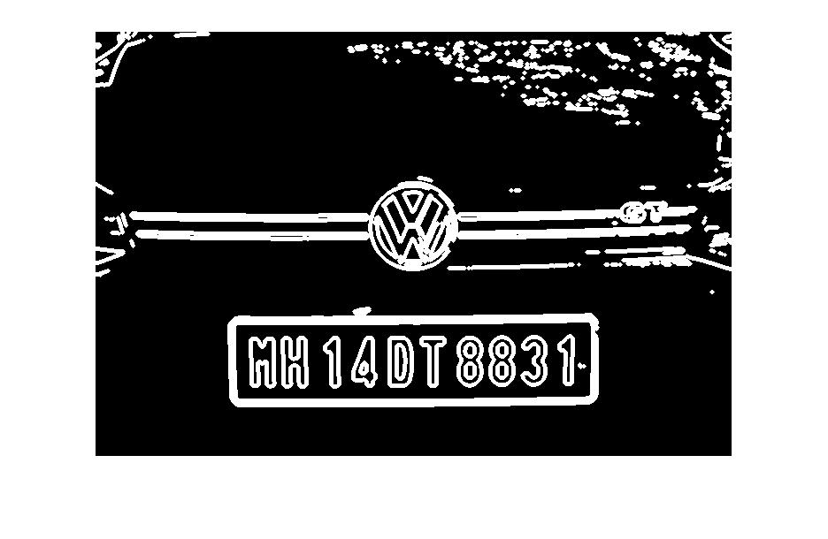
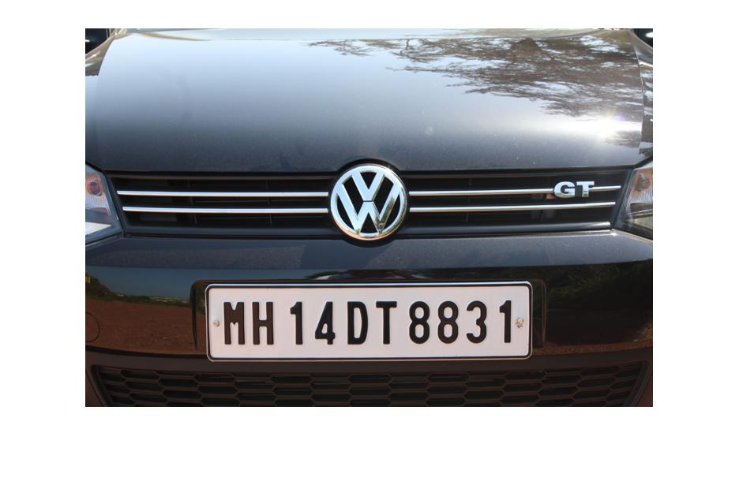
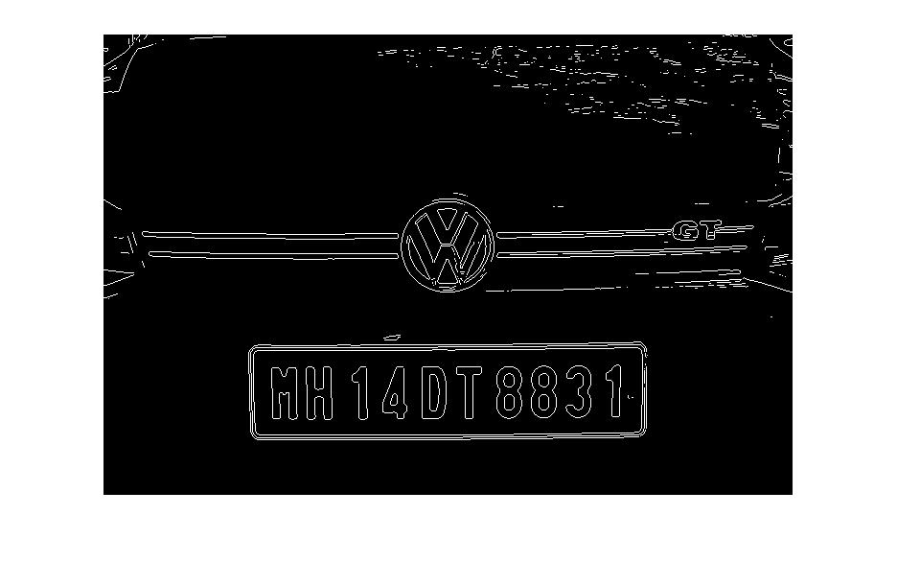
Detect and localize a license plate
edge.m (on the grayscale)
imdilate.m
imfill.m
imerode.m
Acquire the area of the largest object, which should be the license plate
Notes:
As a breakdown of how I implemented the process of detect and localize a plate. We will first start with the input image as shown here. I will be taking advantage of built-in MATLAB functions, and MATLAB is actually a phenomenal tool when it comes to image processing in general just because of a variety of existing functions that make the job a lot easier.
First I used the edge built-in function on the grayscaled version of the license plate. What the edge function does is it takes an intensity image an input, and returns a binary image of the same size, with 1's where the function
finds edges and 0's elsewhere.
Next I’ll apply the imdilate function, which basically dilate the edges and essentially bold the entire image
Next, imfill basically fill in all the spaces in between the edges.
Last but not least, imerode just erode all the ones in the image and returns the version that we see on the right here.
We have just gone through this entire process with the main objective to acquire the area of the largest object, which should be the license plate if the above steps were followed in the listed order. The circle here is the car brand, and for all cases, the area of interest should be the license plate.

Slide 12
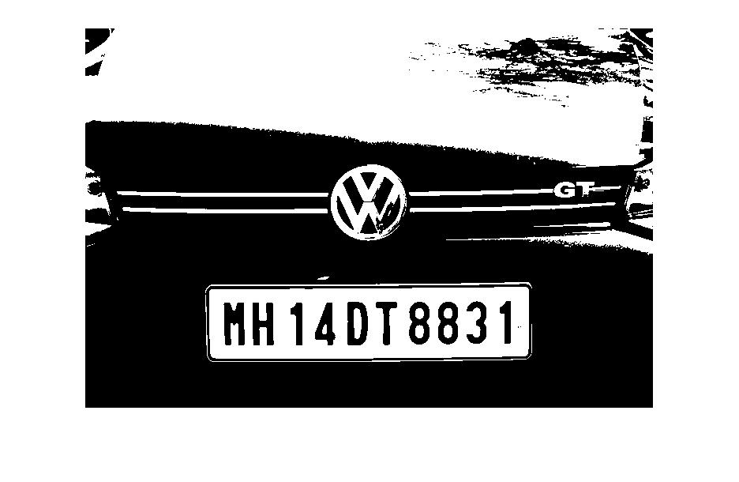

Detect and localize a license plate
imbinarize.m (on the grayscale)
Crop out the area acquired from the previous slide
im = bwareaopen(~im, 500);
Notes:
Now that we have the area of the license plate. We will return to the original input image, then apply imbinarize on the grayscaled version, which simply return a binary version of the image.
I can then crop out the area acquired from the previous slide, which should isolate the plate from the car.
Next up, the tilde symbol stands for logical NOT, and essentially flip all 1s to 0 and all 0 to 1s. This command here is used to removes from a binary image all connected components (objects) that have fewer than 500 pixels. This should be able to remove dusts or screws or other objects that should not be apart of the license plate.
The reason for flipping the 0 and 1 in the image does wonder to help MATLAB with the later steps in this ANPR system. I like to think of relevant information as ones, and irrelevant information as 0, which align with the image on the bottom right here.

Slide 13

Processing Procedure – anprGUI.m
Detect and localize a license plate in an input image/frame.
Extract the features/characters from the license plate.
Apply OCR algorithms to recognize the characters.
Step #1
Step #2
Step #3
Notes:
So step 1 allowed us to detect and localize the license plate. Step 2 is to extract the features and characters from the license plate.

Slide 14
Extract the characters from the plate
Utilized MATLAB’s regionprops function, which works exceptionally well with binary images.
Limitations:
The letter ‘i’, which the dot is separated from the actual letter. – should not be a problem because all characters should be capitalized.
: and ; - should not be a problem because license plates does not contain these special characters.
Notes:
And once again, I was able to utilize MATLAB’s regionprops function, which works exceptionally well with binary image.
REGIONPROPS Measure properties of image regions and it works with both continuous and discontinuous regions. However, we’re actually only interested in continuous regions because it’d actually be two separate objects if the properties are discontinuous.
As we can see here, the license plate are separated nicely into an array of single characters, and I recommend everyone to look into this powerful built-in function at some point in the future as I was able to make a lot of short cuts while doing this project.
Some limitation include the lowercase I, which like I mentioned before, is actually a discontinuous property and would derive two separate objects. However, it should not be an issue for ANPR system because all characters on the license plate should be capitalized.
Another limitation is colon and semicolon, which again are discontinuous, but it should not be a problem as license plates should not contain these special characters.

Slide 15
Processing Procedure – anprGUI.m
Detect and localize a license plate in an input image/frame.
Extract the features/characters from the license plate.
Apply OCR algorithms to recognize the characters.
Step #1
Step #2
Step #3
Notes:
And last but not least, the last step is to apply an OCR algorithm to recognize the characters.

Slide 16
Template matching
Simplest form of OCR: template matching
Load templates of characters in the memory, then correlate each input character with every characters in the system for best match.
Limitations:
Would not do well with bad templates
Poor processing techniques
Missing templates
Notes:
Due to the time constraint of the project, I have settled for the simplest form of OCR, which is in my opinion, template matching.
Template matching is basically the idea of correlating each input character with every characters in the memory of the system for the best match.
Some obvious limitations include the inability to work well if the system have bad templates.
Poor processing techniques or missing templates in the memory.

Slide 17
Summary
“Front-loading” is very important when it comes to any recognition system, and more specifically, ANPR systems in this case.
Highlight the importance of fast shutter speed settings to avoid motion blur in certain application (highway traffic) – a working progress.
Existing ANPR systems excel in smaller scale applications, such as surveillance and fast -food drive through.
Source: https://www.businesswire.com/news/home/20170524005697/en/Global-Automatic-Number-Plate-Recognition-Market-Projected-to-be-Worth-USD-1112.5-Million-by-2021-Technavio
Notes:
As a summary, front-loading is a very important concept when it comes to any image recognition system, and for this presentation, the idea stay true for ANPR system. It’s essentially the idea that emphasize the importance of having good input for the system to work precisely.
As mentioned before, motion blur is one of the major limitation that we will need to take into consideration when implementing the camera setup. Not so much for slower application like fast food drive through, but more so faster applications such as highway traffic.
Again existing ANPR systems excel in smaller scale applications, such as home surveillance and fast-food drive through.
On the right here, I have included a pie chart showing global ANPR market by application and I just thought it was an interesting visual to analyze.

Slide 18
MATLAB DEMO
github.com/xhungn

